Slide 1




From Automated Theorem Proving to Automated Meta-Logical Reasoning
Kevin O’Neill
Selmer Bringsjord
Department of Cognitive Science
Department of Computer Science
Lally School of Management & Technology
Rensselaer Polytechnic Institute (RPI)
Troy, New York 12180 USA

Slide 2
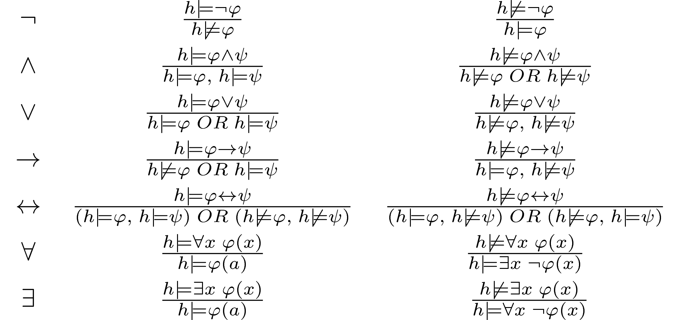
Background (Truth Trees & First-Order Logic)
Syntax/Semantics
Predicates, connectives, quantifiers
Tarski’s truth function
Inference Rules
Decomposition rules (alpha rules)
Branch rules (beta rules)
Instantiation rules (gamma & delta rules)

Slide 3
MetaProver - Automated FOL
Java 8
Tree of HashMaps
Interactive GUI
Highly efficient
Extensively parallelized
Streaming, lambda functions
 | # Problems | Total Execution Time (ms) | Mean Execution Time (ms) | Median Execution Time (ms)
Propositional Logic | 80 | 334 | 4.175 | 2
First-Order Logic | 41 | 7531 | 184 | 5

Slide 4
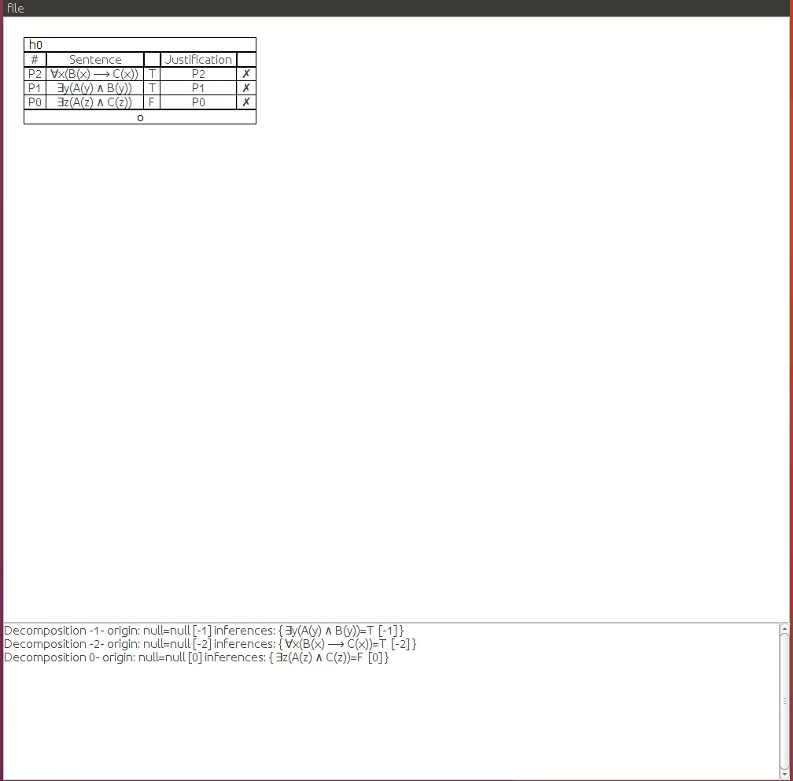
FOL Example

Slide 5
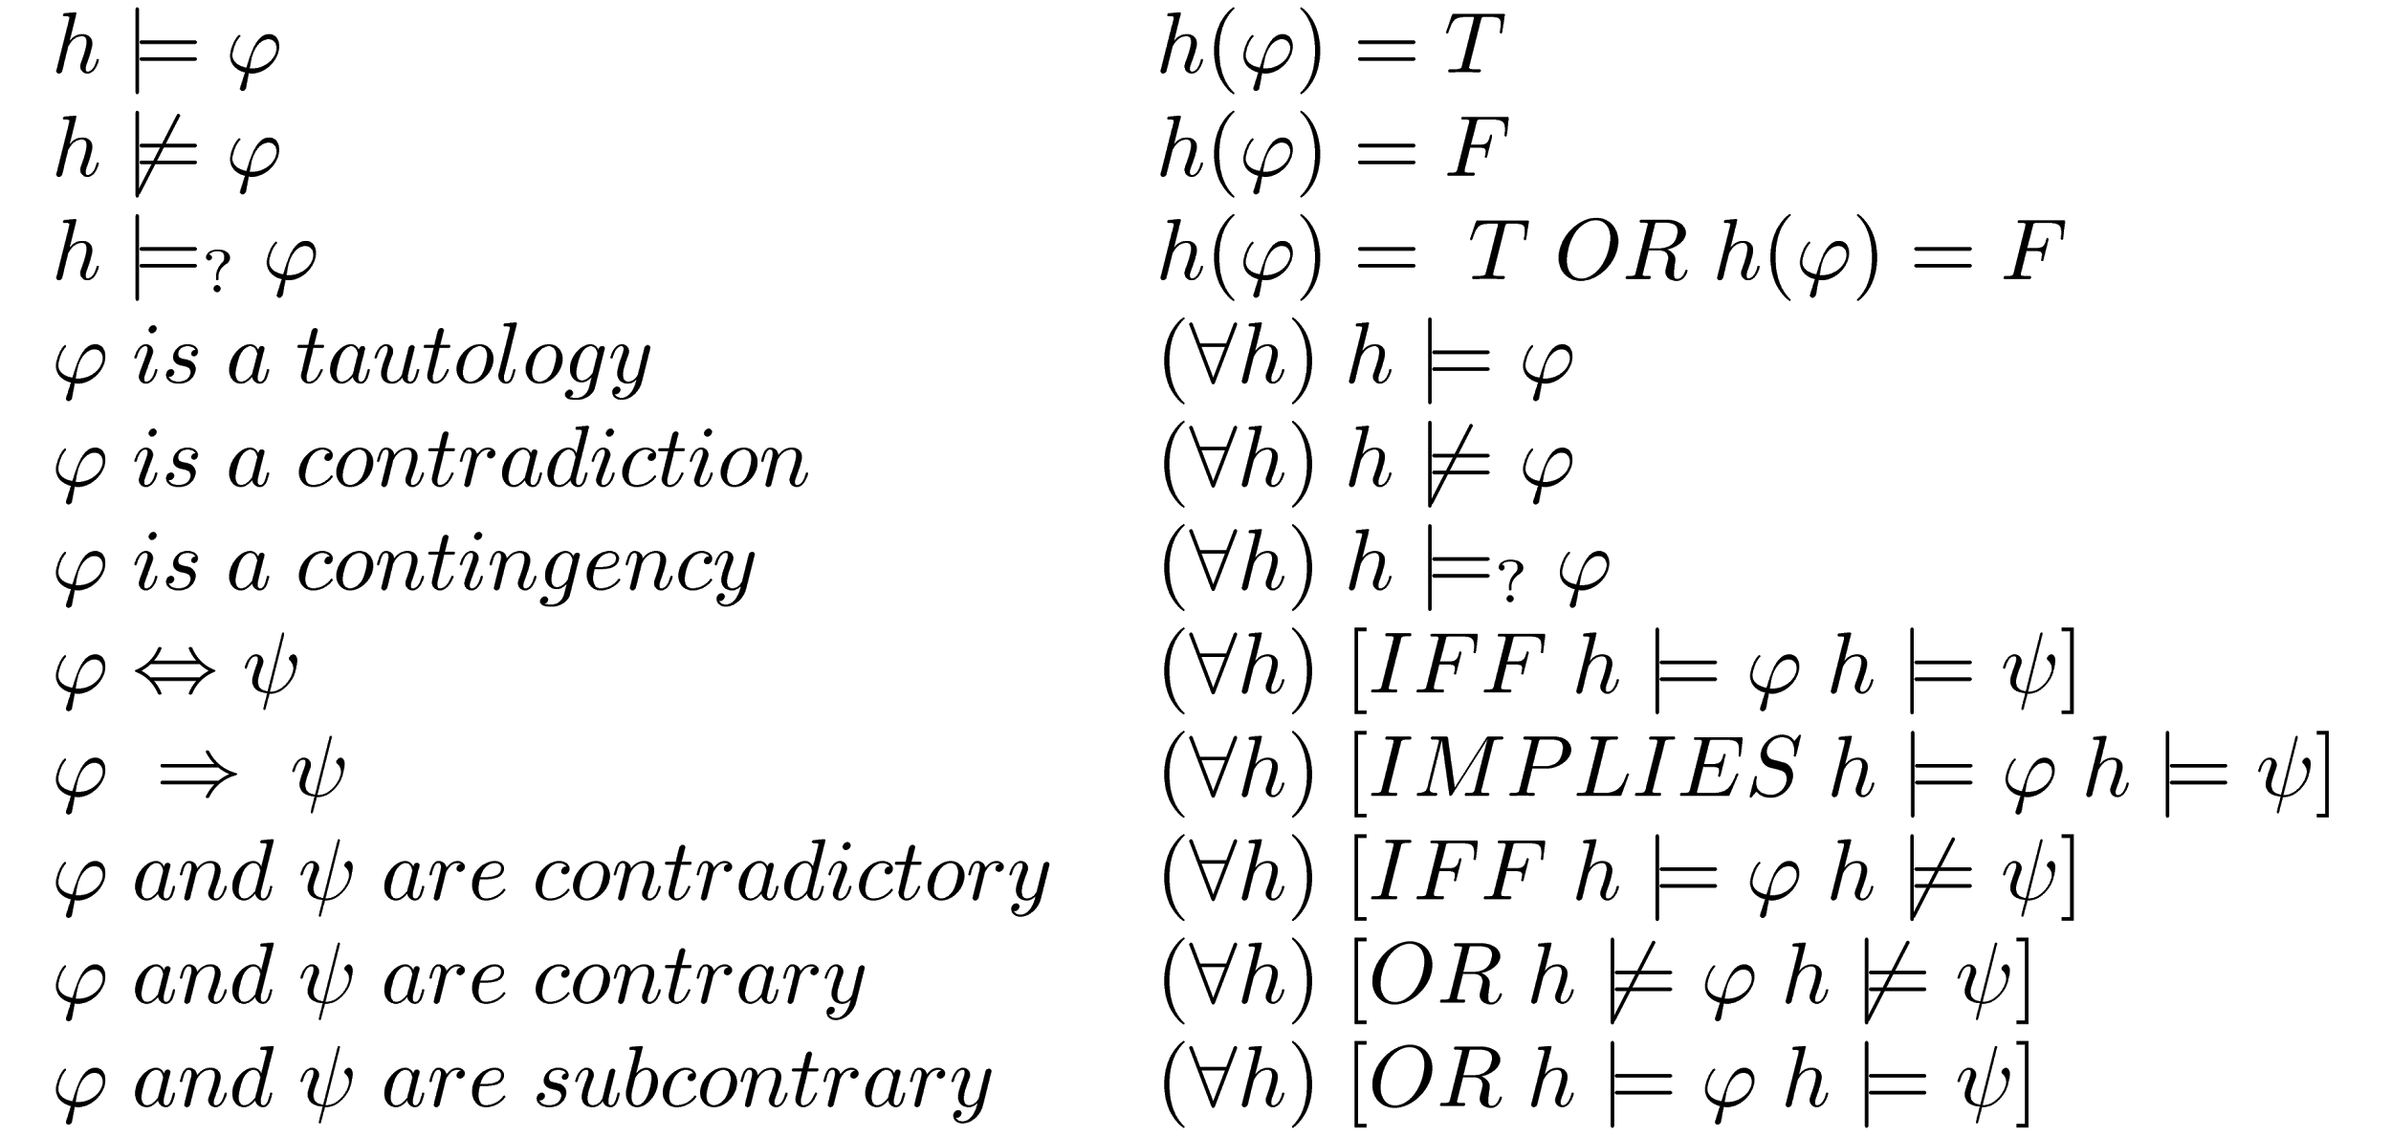
Background (Meta-Logic)
Logic about logic
Soundness and completeness
Gödel (in)completeness
Validity, consistency, etc.
“Pure” vs. formal logic
Formal Semantics

Slide 6
MetaProver - Automated Metalogic
Extension of FOL package
Dedicated proof search
Efficient Performance
190ms for 10 problems
Approach
Truth tree ⇔ truth function
Implicit quantification
Basic algorithm
Apply definition rules
Apply semantic rules
Unify truth functions

Slide 7
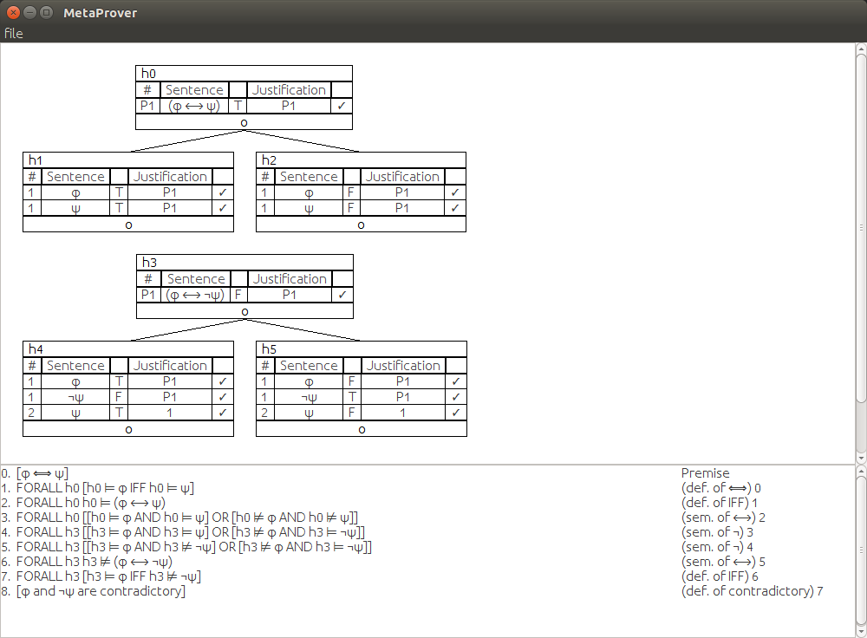
Meta-Logic Example

Slide 8
Applications, Implications
Logicist AI (ATP)
Proof assistance & visualization
Education
Model/Proof theoretic semantics
Meta-meta-logic ?
Unification of logics (bootstrapping)

Slide 9
Future Research
Testing & performance metrics
Proof tactics & heuristics
Full typed FOL, Modal Logic
Meta-logic over FOL
Interpretations, infinite models
User friendliness

Slide 10
References
Hodges, Wilfrid, "Tarski's Truth Definitions", The Stanford Encyclopedia of Philosophy (Fall 2014 Edition), Edward N. Zalta (ed.), URL = <https://plato.stanford.edu/archives/fall2014/entries/tarski-truth/>.
Bergmann, Merrie (2003). The Logic Book. Mcgraw-Hill.
Schroeder-Heister, Peter, "Proof-Theoretic Semantics", The Stanford Encyclopedia of Philosophy (Winter 2016 Edition), Edward N. Zalta (ed.), URL = <https://plato.stanford.edu/archives/win2016/entries/proof-theoretic-semantics/>.
Sutcliffe, Geoff. "Automated Theorem Proving." An Overview of Automated Theorem Proving. Web.
Raymond Smullyan, 1995 (1968). First Order-Logic. Dover Publications.

